Slide 1
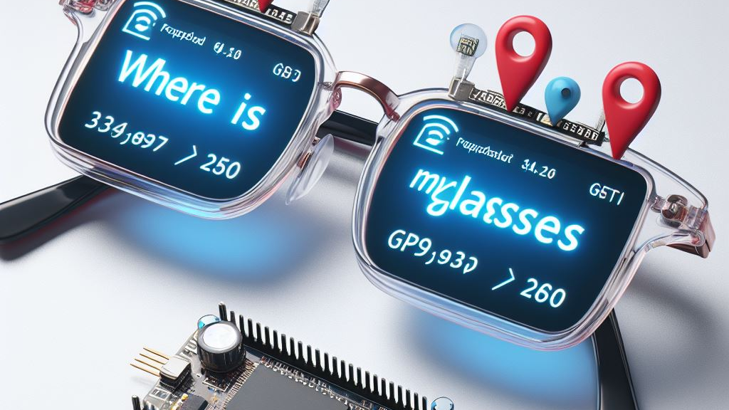
Auto Reminder Device
Tal Frank
Oren Lowte

Slide 2
Table of Contents
The Problem
The Big Idea
Main Components
AWS cloud and MQTT
Security
Related Work
Future Work
Notes:
When we leave home, all most all of us check a thousand times if they left anything important behind. And a lot of those cases we do forget to take something like our glasses or wallet.

Slide 3
The Problem
Story Time
Head to the cinema.
Buy popcorn and snacks.
Sit down in the comfortable seat.
Realize that I forgot my reading glasses.
Wonder what is going on in the movie?!
Notes:
רצינו למצוא פתרון לשכיחת דברים חשובים.
להביא חידוש שלא קיים

Slide 4
Can you relate to that ?
Notes:
רצינו למצוא פתרון לשכיחת דברים חשובים.
להביא חידוש שלא קיים

Slide 5
Introduction
Our idea,
Create a smart device that will notice when you leave home
If you left without your glasses, it would remind you to go back and get them.
Use IOT to solve it

Slide 6
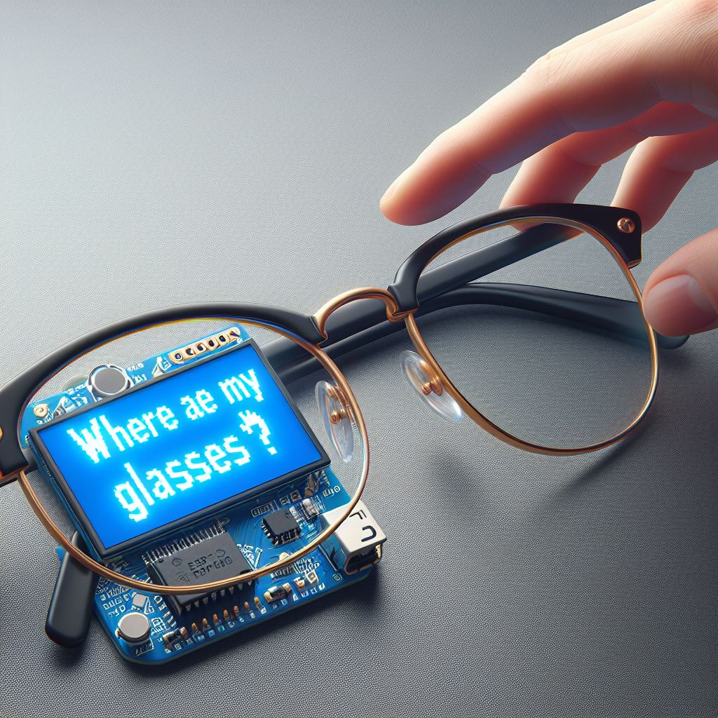
The Big Idea
Tracker and transmitter with only Wi-Fi.
Receiving a massive amount of data.
Process the data.
Update software.
Notes:
If it Ain’t Broke…
Wifi add accurate
בלוטוס הוא לא למרחקים גדולים, אנחנו רוצים משהו שיהווה תחליף כשעובדים או נמצאים במקום גדול

Slide 7

Notes:
רצינו למצוא פתרון לשכיחת דברים חשובים.
להביא חידוש שלא קיים

Slide 8
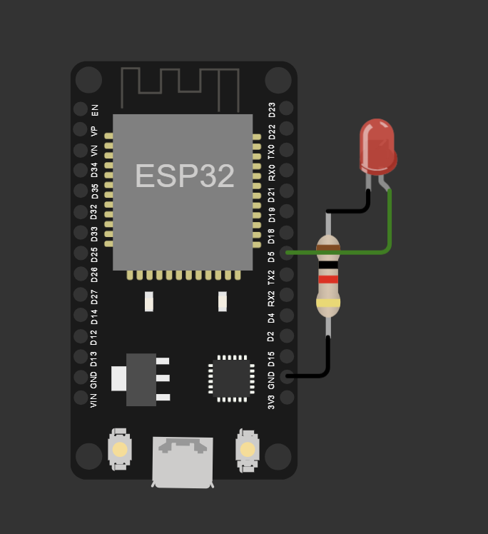
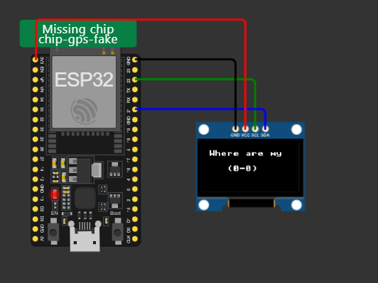
Hardware
Two ESP32
Led
LCD Screen
Battery

Slide 9
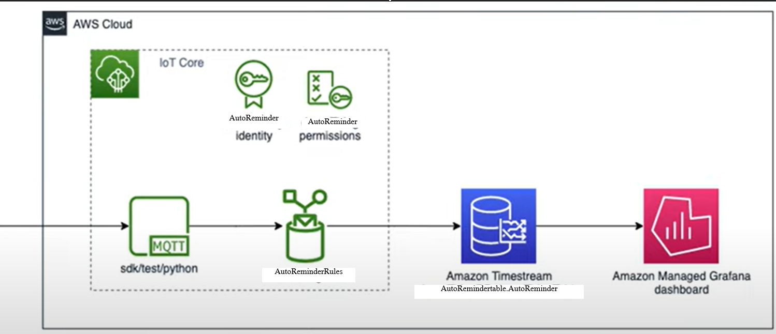
Auto Reminder Device Flow
Notes:
רצינו למצוא פתרון לשכיחת דברים חשובים.
להביא חידוש שלא קיים

Slide 10

AWS cload and MQTT
Example in python of MQTT protocol based.
message_json = json.dumps(
{
"time":int(random_time.timestamp()),
"user_name": user_list[index],
"location": gps_list[index],
"Got_back“ :count_yes,
"forgot“ :count_general,
},
Notes:
רצינו למצוא פתרון לשכיחת דברים חשובים.
להביא חידוש שלא קיים

Slide 11
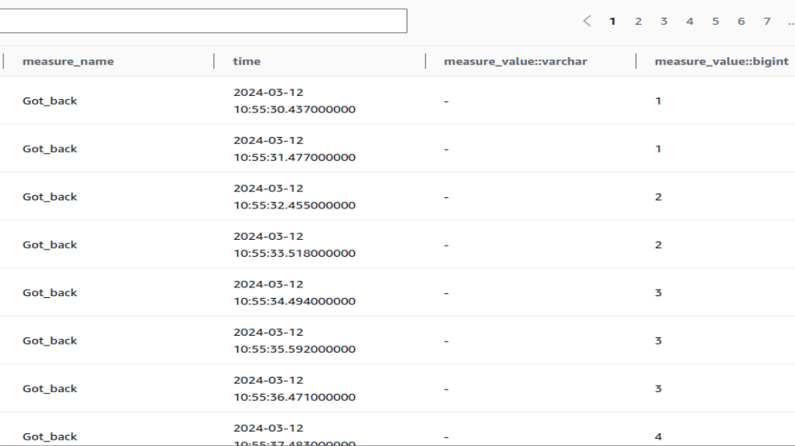
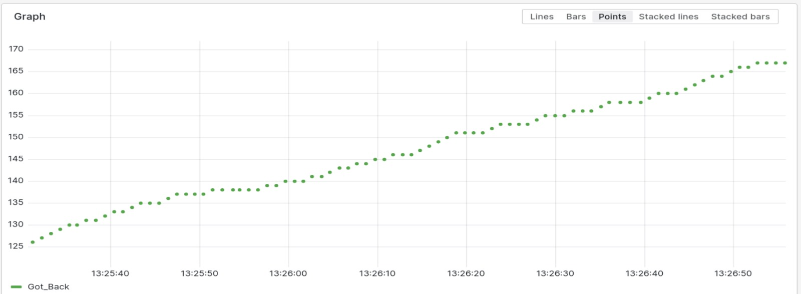

MQTT messages and Grafana
Notes:
רצינו למצוא פתרון לשכיחת דברים חשובים.
להביא חידוש שלא קיים

Slide 12
Position Tracking Using WiFi by Dr. John Kapenga
Problem:
GPS lacks accuracy inside buildings, making it unreliable for intra-building tracking.
There’s a need for a more precise location tracking system within structures.
Solution:
WiFi-based location tracking is used as an alternative to GPS for more accurate indoor positioning.
The system involves devices that can send emergency messages and location information to a central
4559server.
Devices use Arduino Uno and WiFi Shield to transmit data through WiFi.
A Central Server receives transmissions and displays device locations on a building map.
Notes:
רצינו למצוא פתרון לשכיחת דברים חשובים.
להביא חידוש שלא קיים

Slide 13
security

Slide 14
Future Work
Add more smart devices that can connect to our transmitter.
Add an application that can manage the devices smartly to avoid false alarms.

Slide 15
Thank You For Listening
Questions?
Tal & Oren

Slide 16

THANK YOU!

